Slide 1

Technical Choices over 3 years: MVP to $1M ARR

Slide 2



Market Opportunity (in Billions)
Drivers
Expanded Internet Access
Encryption Everywhere
15x Increase in Attacks
Notes:
DNSFilter serves a MASSIVE market that will experience 3x growth by 2022, and is driven by three trends: increased access to public wifi, a push for encryption which defeats traditional solutions and a 15x increase in phishing attacks in the last two years.
We recognized the opportunity, and built the best technical solution for our target customers - IT providers and small enterprise.

Slide 3
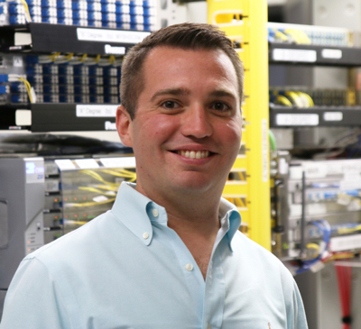
Summary of business & opportunity
Cloud-based Security Protection and Content Filtering
Alternatives: On-Site Hardware, Small, Foreign, Not technically strong competitors
Market Opportunity: Cisco Bought OpenDNS in 2015
Big & Growing Market - $13B to $22B over next 7 years.
Ken Carnesi
CEO

Slide 4
Mike Schroll
BS: Rochester Institute of Technology MS: Tufts University
10 years Information Security Penetration Testing
VP at Anti-virus company
Previous startups: Raised funds, TechStars alum -- Startup Weekend
Not a Developer - Pretends to be a developer.

Slide 5
MVP Path
~$20k seed funding - prepayment Formed company Oct 1st, 2015.
Hired friend developer Adam as contractor - 90 day dev plan. $6k fixed plan + $85/hr

Slide 6
Primary architecture for MVP
Three Primary Components:
Query Processor - Handles incoming DNS Requests
API - Allows setting a filtering policy, identifying customers and their networks
Admin Interface - UI to set customer settings

Slide 7
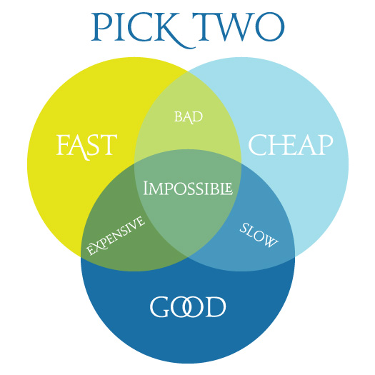

Slide 8
My version - Choosing a Software languages for MVP
Tech - Does it meet necessary technical requirements?
Talent - Are developers available, skilled, and inexpensive?
Trend - Where is the language in the lifecycle of popularity, support, community?

Slide 9
Language choice - query processor
Golang
Tech: We needed low ram, low cpu overhead - compiled Concurrency - thousands of requests per second Others considered, but a popular, open-source DNS library sealed the deal.
Talent: Not a ton of developers; more pricey - This was our risk.
Trend: Early-Mid in the trend, supported by Google

Slide 10
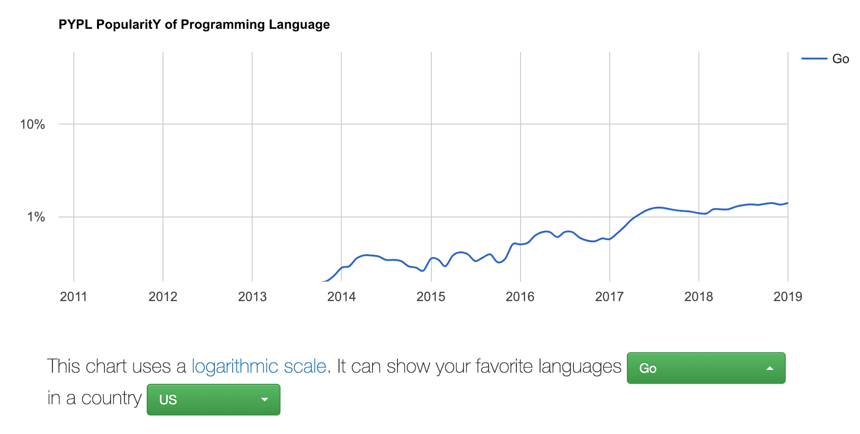

Slide 11
Language choice - API
Ruby on Rails
Tech: Fast to develop, not fast to execute. Not as easily scaled.
Talent: Readily available, not too expensive.
Trend: More mature - Risk of it becoming ‘outdated’

Slide 12
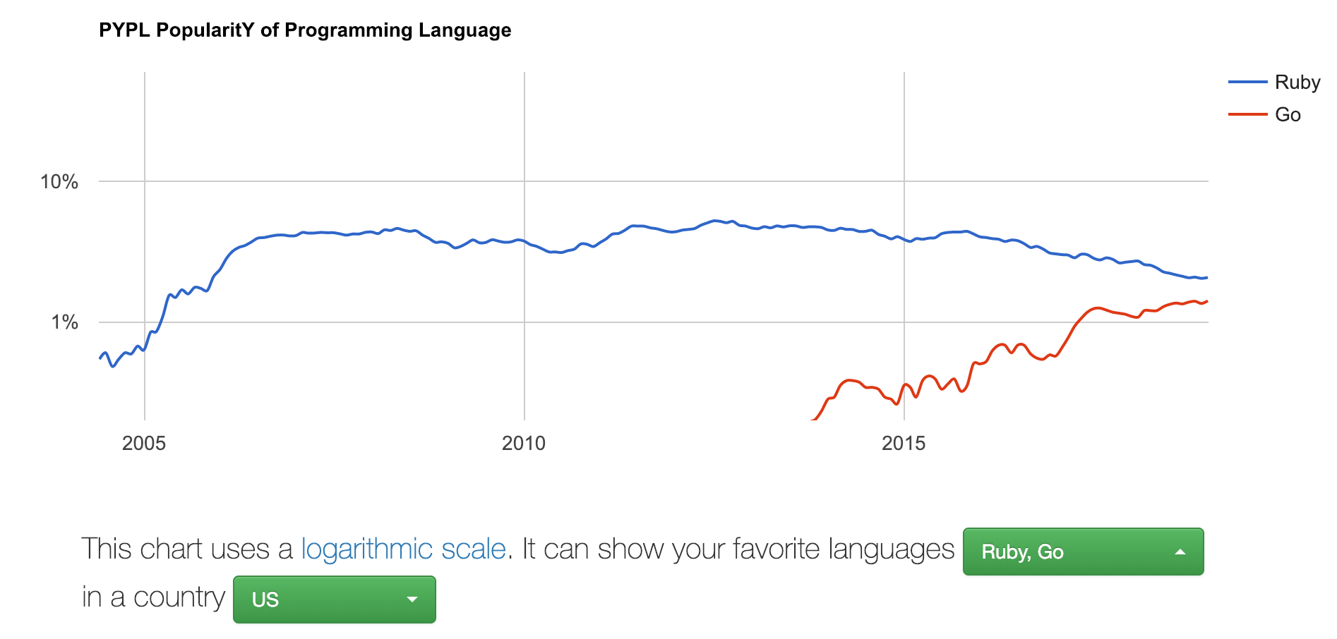

Slide 13
MVP Delivered Late; no Billing

Slide 14
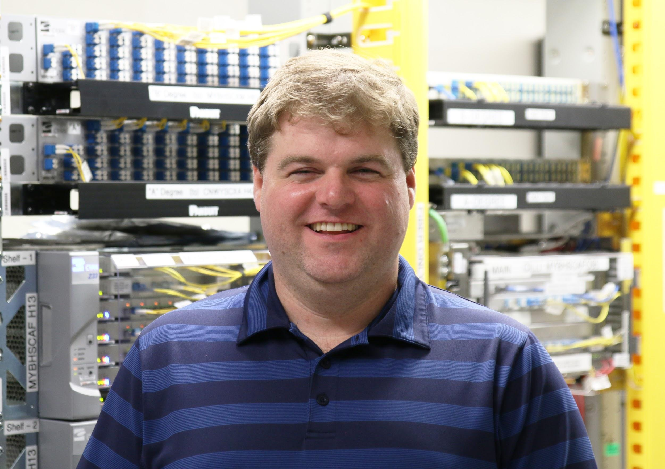
Bring on third Co-Founder
Equity Only
Brian Gillis
CIO

Slide 15
language choice front end - React
Hired Brazil Developer on Upwork

Slide 16
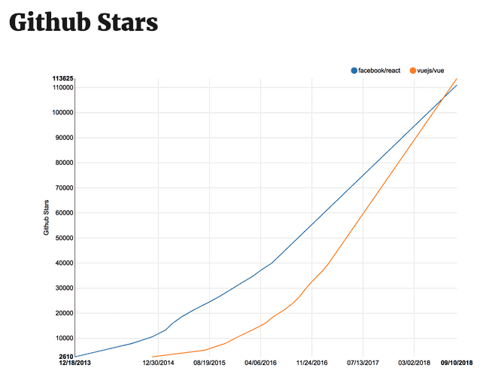

Slide 17
Fast-Forward 1 year
That was Summer 2016 - Went into Private Beta I did all golang coding Spring 2016 -> Summer 2017
January 2017: Started Charging Customers Spring 2017: Raised $300k; started to my co-founders salaries.
Summer 2017 - Hired Colombia Dev - Golang, Ruby on Rails… more (C#) Traded one Brazil FE Dev on upwork for another (his friend) after first dev became Nomad. Timezone issues.

Slide 18
2018 - Focus on Business
We ended 2017 at $20k MRR - $240k ARR
Jan 2018 - TechStars Anywhere program
April 2018 - Acquired Webshrinker
First company meetup; August 2018; team of 6. Now: Team 14 Ended 2018 at $1.2M ARR. 500% growth in 2018.

Slide 19
Contractors vs Employees - Lessons Learned
Contractors don’t care about the company as much.
No strong contribution to company culture.
Not a ‘team player’ -- their mind is split between multiple clients.
Our best hires go contractor -> Employee over 30-90 days

Slide 20
Current Team Breakdown
Bohdan - Ukraine - FTE: Frontend React Daniel - Colombia - FTE: Backend Ruby on Rails, GoLang, C#, more… JP - Colombia - FTE: Backend Ruby on Rails Adam - Long Island - FTE: Python, AI/Machine Learning, JavaScript Heron - Brazil - FTE: QA Rafael - Brazil - Part Time Upwork: Frontend React Brian - Albany, NY - FTE, Co-Founder: Ruby on Rails Mike - Myrtle Beach, SC - FTE, Co-Founder: Golang, DevOps Ken - Washington, DC - FTE, Co-Founder: Sales, Marketing, HTML Mikey - Myrtle Beach, SC - PT -> FTE: DevOps Bryan - Washington, DC - FTE: Sales Engineer Josh - Augusta, GA - FTE: Was support, now BizDev Jordan - Greenville, SC - FTE: Support Danny - Washington, DC - PT -> FTE: Business Analyst Cast of Contractors for iOS, Android, etc.

Slide 21
Reflecting on our choices…
Golang: Perfect choice; performance great -- new versions come out regularly with features that improve our performance and capabilities.
Ruby on Rails: Getting slow, getting old -- Devs are looking into migrating to Elixir - Could make future hiring more difficult.
Node.js - React. Facebook association is hurting it. Vue.js is the new hotness. Not as many Vue devs.

Slide 22
language choice front end - do we switch?
node not trendy, facebook negative press, vue
Bohdan

Slide 24
language choice api - switching
ruby slow, elixir trendier
plenty of developers

Slide 25
challenges, but still good now
very deep technical, but working out well
great performance choice
quick stats

